Slide 1
Root and Rule-Based Natural Language Processing:
Subject-Predicate-Object Phrases
Jonah Tash and Peter Zhang

Slide 2
Motivation
We have used our root and rule-based program to create terms and sentences from scientific articles
We want to express the terms and sentences in subject-predicate-object groups

Slide 3
Example
The crystal packing is mainly stabilized by van der Waals interactions
crystal:0:packing
van:2:der:1:waals:0:interacitons
crystal packing
stabilized by
Van der Waals interactions
Subject
Predicate Phrase
Object
Tian, L. & Liu, L.-Z. (2004). Acta Cryst. E60, o1826-o1827.

Slide 4
Tagging
Searching
Clustering
Filtering
Phrasing
Process

Slide 5
Input
Used the original phrases and the fragmented terms
Considered only short terms
Terms of level 0, 1 and 2
Subjects and objects should be concise

Slide 6
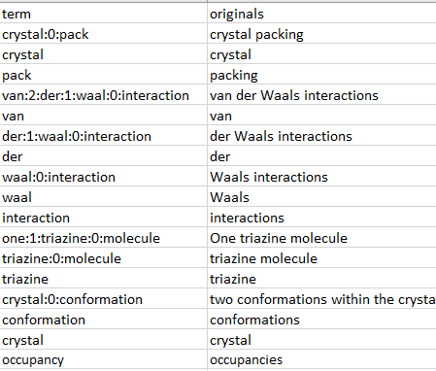
Input
The crystal packing is mainly stabilized by van der Waals interactions
One triazine molecule is disordered over two conformations within the crystal, the occupancies being 62 emsp14 (1) and 38 emsp14

Slide 7
Step 1: Tagging Verbs
Use the part-of-speech tagger in the Natural Language Toolkit (NLTK) library to identify verbs
The model can isolate the sense of a word
E.g. “report” noun vs. “report” verb
Found at: https://www.nltk.org/

Slide 8
Step 1: Tagging Verbs
NLTK is not perfect
Check results with Princeton’s WordNet lexicon
Removes words that are incorrectly classified as verbs
E.g. symbols, molecule names
Found at: https://wordnet.princeton.edu/

Slide 9
Step 2: Searching for Verbs
Classify terms into Level 0, 1, and 2 by maximum colon number
Higher level means a longer phrase
E.g. “crystal:0:packing” ⇨ Level 0
“van:2:der:1:waal:0:interaction” ⇨ Level 2

Slide 10
Step 2: Searching for Verbs
Search the span between subject and object for verbs
E.g. between “crystal packing” and “Van der Waal interactions”
Count the number of characters and words in the span
The crystal packing is mainly stabilized by van der Waals interactions
Span
Characters: 23
Words: 4

Slide 11
Step 3: Phrasing
A verb by itself is not enough information
Use the Collaborative International Dictionary of English to capture conjugations of the verb
Hand-collected a list of English conjugations
E.g. is linking, was linked, will link
Found at: http://www.ibiblio.org/webster/

Slide 12
Step 3: Phrasing
Reference the Pattern Dictionary of English Propositions to append neighboring prepositions
e.g. “stabilized” ⇨ “stabilized by”
“connect” ⇨ “connect to”
“extracting” ⇨ “extracting from”
Found at: https://www.clres.com/pdep.html

Slide 13
Step 4: Clustering
Want to group similar verb phrases
Reference the British National Corpus to find the “stem” of each verb phrase
E.g. “is” ⇨ “be”
“stabilized by” ⇨ “stabilize”
Found at: https://github.com/skywind3000/lemma.en

Slide 14
Step 4: Clustering
Reference the Princeton’s WordNet lexicon to find synonyms for the stems
Use these to cluster similar phrases
E.g. “appear” ⇨ {“appear”, “seem”, “look”}
“bond” ⇨ {“bond”, “bind”, “attach”, “adhere”, “stick”}
Found at: https://wordnet.princeton.edu/

Slide 15
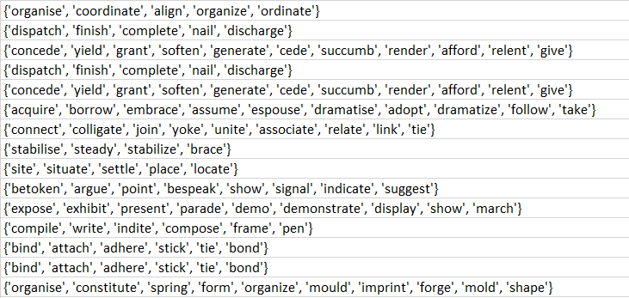
Step 4: Clustering

Slide 16
Step 5: Filtering
Count the number of each subject, predicate, object, and verb stem
Sort by frequency and identify phrases to filter
Some predicate phrases lack meaningful relation
E.g. “is”, “was”, “are”, “have”
Compile phrases to filter

Slide 17
Output
Output to a CSV file with the following columns:
Subject, Object, Predicate
Sentence
Stem and Synonyms
Frequencies of Subject, Object, Predicates and Stems
R&R Terms for Subject, Object, and Predicate
Document ID

Slide 18
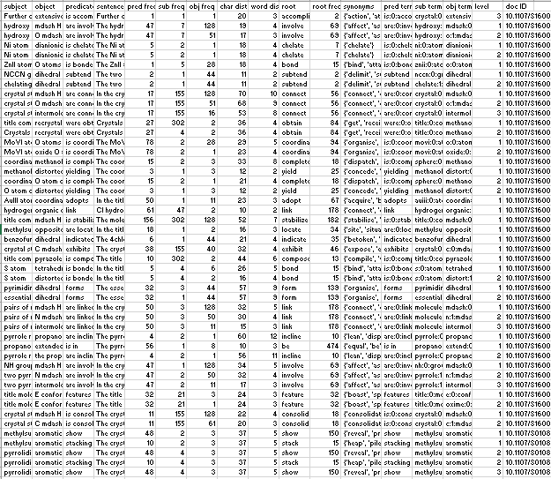
Output
For an input of 67k terms, the program extracts 5700+ phrases in under 15 seconds

Slide 19
Implementation
The program was written in Python with use of the CSV and SQLite3 libraries
Compilers for the verb, predicate, and lemma databases are available as separate programs

